Slide 1

Database Management System
Lecture 7
Er. Shiva Kunwar
Lecturer, GU

Slide 2
Lesson 2: Data Model (6hrs)
Different Data Model Concepts
E-R Model
Network/Hierarchical Model
Relational Model
Entities, Relationships and Attributes
E-R Diagrams, Keys
Generalization, Specialization and Aggregation
Notes:
Class discussion on real-world applications of databases.
Quiz on basic database terminology.
Hands-on exercise: Create a simple database using DDL commands.

Slide 3
Topics
E-R diagram
Reducing E-R diagram to tables
Generalization, Specialization and Aggregation
Notes:
Class discussion on real-world applications of databases.
Quiz on basic database terminology.
Hands-on exercise: Create a simple database using DDL commands.

Slide 4
ER Diagram Example
In a university, a Student enrolls in Courses. A student must be assigned to at least one or more Courses. Each course is taught by a single Professor. To maintain instruction quality, a Professor can deliver only one course.
Notes:
Class discussion on real-world applications of databases.
Quiz on basic database terminology.
Hands-on exercise: Create a simple database using DDL commands.

Slide 5
Example
Step 1) Entity Identification
We have three entities
Student
Course
Professor
Notes:
Class discussion on real-world applications of databases.
Quiz on basic database terminology.
Hands-on exercise: Create a simple database using DDL commands.

Slide 6
Example
Step 2) Relationship Identification
We have the following two relationships
The student is assigned a course
Professor delivers a course
Notes:
Class discussion on real-world applications of databases.
Quiz on basic database terminology.
Hands-on exercise: Create a simple database using DDL commands.

Slide 7
Example
Step 4) Identify Attributes
Once, you have a list of Attributes, you need to map them to the identified entities. Ensure an attribute is to be paired with exactly one entity. If you think an attribute should belong to more than one entity, use a modifier to make it unique.
Once the mapping is done, identify the primary Keys. If a unique key is not readily available, create one.
Notes:
Class discussion on real-world applications of databases.
Quiz on basic database terminology.
Hands-on exercise: Create a simple database using DDL commands.

Slide 8
Example
Step 4) Identify Attributes
Entity Primary Key Attribute
Student Student_ID StudentName
Professor Employee_ID ProfessorName
Course Course_ID CourseName
Notes:
Class discussion on real-world applications of databases.
Quiz on basic database terminology.
Hands-on exercise: Create a simple database using DDL commands.

Slide 9
Example
Step 4) Cardinality Identification
For them problem statement we know that,
A student can be assigned multiple courses
A Professor can deliver only one course
Notes:
Class discussion on real-world applications of databases.
Quiz on basic database terminology.
Hands-on exercise: Create a simple database using DDL commands.

Slide 10
Practical
Construct an ER diagram for a car insurance company with a registration id and an address and have name and address of its customers. Each customer own one or more cars which has its model, color and engine number. Each car is associated with zero or any number of recorded accidents.
Notes:
Class discussion on real-world applications of databases.
Quiz on basic database terminology.
Hands-on exercise: Create a simple database using DDL commands.

Slide 11
Practical
UPS prides itself on having up-to-date information on the processing and current location of each shipped item. To do this, UPS relies on a company-wide information system. Shipped items are the heart of the UPS product tracking information system.
Shipped items can be characterized by item number (unique), weight, dimensions, insurance amount, destination, and final delivery date. Shipped items are received into the UPS system at a single retail center.
Retail centers are characterized by their type, uniqueID, and address. Shipped items make their way to their destination via one or more standard UPS transportation events (i.e., flights, truck deliveries). These transportation events are characterized by a unique scheduleNumber, a type (e.g, flight, truck), and a deliveryRoute.
Prepare an ER Diagram that captures this information.
Notes:
Class discussion on real-world applications of databases.
Quiz on basic database terminology.
Hands-on exercise: Create a simple database using DDL commands.

Slide 12
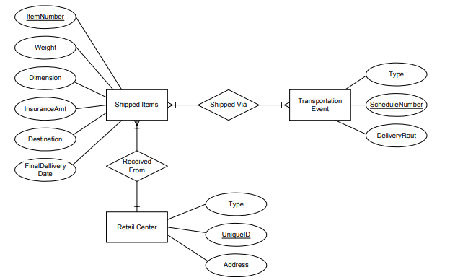
Practical
Notes:
Class discussion on real-world applications of databases.
Quiz on basic database terminology.
Hands-on exercise: Create a simple database using DDL commands.

Slide 13
Reducing ER Diagrams to Table
We can represent the E-R database schema by a set of tables.
Each entity sets and each relationship sets in E-R schema can be represented by their corresponding tables.
Each attributes of entity sets, and relationship sets are map as columns of their corresponding tables.
Similarly, constraints specified in E-R diagram such as primary key, cardinality constraints etc. are mapped to tables generated from E-R diagram.
In fact, representing E-R schema into tables is converting E-R model of database into relational model
Notes:
Class discussion on real-world applications of databases.
Quiz on basic database terminology.
Hands-on exercise: Create a simple database using DDL commands.

Slide 14
Reducing ER Diagrams to Table
Consider a simple ER diagram with two entities: "Student" and "Course," and a many-to-many relationship "Enrolls In.“
Student: StudentID, Name, GPA
Course: CourseID, Title, Department
Enrolls In: EnrollmentID (PK), StudentID (FK), CourseID (FK)
Create Tables Student table, Course table, and enrolls table that represent many-to-many relation
Notes:
Class discussion on real-world applications of databases.
Quiz on basic database terminology.
Hands-on exercise: Create a simple database using DDL commands.

Slide 15
Extended ER Features
In the pursuit of enhancing the ER model, several terms and concepts have been incorporated.
Generalization refers to the process of abstracting common features from multiple entities into a more generalized entity, reducing redundancy and promoting a higher level of abstraction.
Specialization, conversely, involves refining a generalized entity into more specialized entities, tailoring attributes and relationships to specific subsets of data.
Aggregation, facilitates the modeling of relationships involving higher-level entities composed of or related to lower-level entities.
Notes:
Class discussion on real-world applications of databases.
Quiz on basic database terminology.
Hands-on exercise: Create a simple database using DDL commands.

Slide 16
Superclass & Subclass
Superclass
A superclass is a generalized entity that contains common attributes and relationships shared by multiple specialized entities or subclasses.
It represents the more abstract, generalized concept.
Subclass
A subclass is a specialized entity that inherits attributes and relationships from a superclass.
It represents a more specific, specialized concept.
Attributes are unique from other subclasses.
Notes:
Class discussion on real-world applications of databases.
Quiz on basic database terminology.
Hands-on exercise: Create a simple database using DDL commands.

Slide 17
Superclass & Subclass
Attributes
shared
Superclass
Subclass 1
Subclass n
Subclass 2
Unique
attributes
Unique
attributes
Unique
attributes
Notes:
Class discussion on real-world applications of databases.
Quiz on basic database terminology.
Hands-on exercise: Create a simple database using DDL commands.

Slide 18
Generalization
It involves abstracting common features from multiple entities to create a more generalized entity.
It is a bottom-up approach.
Characteristics:
Reduces redundancy by identifying and representing commonalities.
Enhances simplicity by creating a higher-level, more abstract entity.
Consider entities like 'Car' and 'Truck.' These entities share common attributes such as 'Make,' 'Model,' and 'Year.' Generalization allows the creation of a more abstract entity called 'Vehicle,' which captures the shared characteristics of both 'Car' and 'Truck.’
Notes:
Class discussion on real-world applications of databases.
Quiz on basic database terminology.
Hands-on exercise: Create a simple database using DDL commands.

Slide 19
Specialization
It involves refining a generalized entity into more specialized entities.
It is a top-down approach.
Characteristics:
Allows for the representation of diverse entities with unique characteristics.
Enables the modeling of specific subtypes within a broader category.
Building upon the 'Vehicle' entity, specialization creates more specific entities like 'Car' and 'Truck,' each inheriting the common attributes from the 'Vehicle' entity while adding attributes specific to its type.
This also explains the concept of Inheritance.
Notes:
Class discussion on real-world applications of databases.
Quiz on basic database terminology.
Hands-on exercise: Create a simple database using DDL commands.

Slide 20
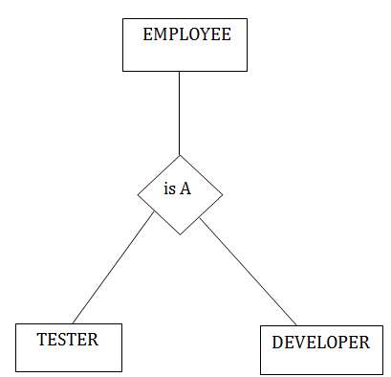
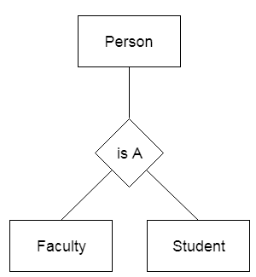
Generalization-Specialization
Notes:
Class discussion on real-world applications of databases.
Quiz on basic database terminology.
Hands-on exercise: Create a simple database using DDL commands.

Slide 21
Generalization-Specialization Constraints
Attribute Constraints
Attributes can be associated with a superclass or a subclass.
An attribute associated with a superclass is shared by all its subclasses.
An attribute associated with a subclass is specific to that subclass.
If 'Person' has a 'Name' attribute, it is shared by both 'Employee' and 'Customer.' If 'Employee' has a 'Salary' attribute, it is specific to the 'Employee' subclass.
Notes:
Class discussion on real-world applications of databases.
Quiz on basic database terminology.
Hands-on exercise: Create a simple database using DDL commands.

Slide 22
Generalization-Specialization Constraints
Disjoint Constraint
Specifies that a superclass entity can belong to only one subclass.
Denoted by a letter "d" next to the line connecting the superclass to the specialization symbol.
If 'Animal' is disjointly specialized into 'Mammal' and 'Bird,' an 'Animal' can be either a 'Mammal' or a 'Bird,' but not both.
Notes:
Class discussion on real-world applications of databases.
Quiz on basic database terminology.
Hands-on exercise: Create a simple database using DDL commands.

Slide 23
Generalization-Specialization Constraints
Overlap Constraint
Allows a superclass entity to belong to more than one subclass.
Denoted by a letter "o" next to the line connecting the superclass to the specialization symbol.
If 'Fruit' is overlapped specialized into 'Citrus' and 'Berry,' a 'Fruit' can be both a 'Citrus' and a 'Berry.'
Notes:
Class discussion on real-world applications of databases.
Quiz on basic database terminology.
Hands-on exercise: Create a simple database using DDL commands.

Slide 24
Generalization-Specialization Constraints
Total Completeness Constraint
Specifies that every superclass entity must belong to at least one subclass.
Denoted by a double line connecting the superclass to the specialization symbol.
If 'Vehicle' is totally specialized into 'Car' and 'Truck,' every 'Vehicle' must be either a 'Car' or a 'Truck.'
Notes:
Class discussion on real-world applications of databases.
Quiz on basic database terminology.
Hands-on exercise: Create a simple database using DDL commands.

Slide 25
Generalization-Specialization Constraints
Partial Completeness Constraint
Allows superclass entities to exist without being members of any subclass.
Denoted by a single line connecting the superclass to the specialization symbol.
If 'Person' is partially specialized into 'Employee' and 'Customer,' a 'Person' can exist without being an 'Employee' or 'Customer.'
Notes:
Class discussion on real-world applications of databases.
Quiz on basic database terminology.
Hands-on exercise: Create a simple database using DDL commands.

Slide 26
Aggregation
Allows modeling of relationships involving higher-level entities composed of or related to lower-level entities.
It helps in representing complex relationships more effectively.
Characteristics:
Useful for expressing complex relationships and hierarchies.
Allows for the creation of composite entities representing a whole-part relationship.
Consider an 'Order' entity that aggregates 'Product' entities. The 'Order' entity represents a higher-level concept that consists of individual 'Product' entities.
Notes:
Class discussion on real-world applications of databases.
Quiz on basic database terminology.
Hands-on exercise: Create a simple database using DDL commands.

Slide 27
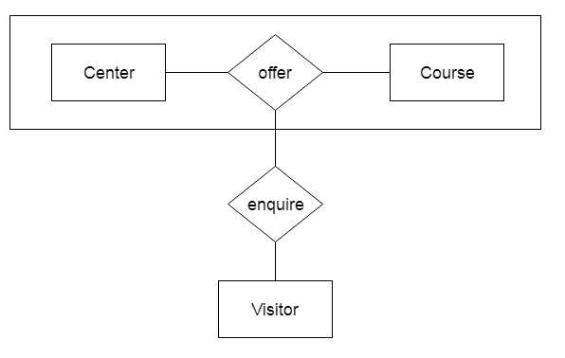
Aggregation
Notes:
Class discussion on real-world applications of databases.
Quiz on basic database terminology.
Hands-on exercise: Create a simple database using DDL commands.

Slide 28
Aggregation Scenario
Managers who manages particular job/task performed by particular employee at particular branch.
Notes:
Class discussion on real-world applications of databases.
Quiz on basic database terminology.
Hands-on exercise: Create a simple database using DDL commands.

Slide 29
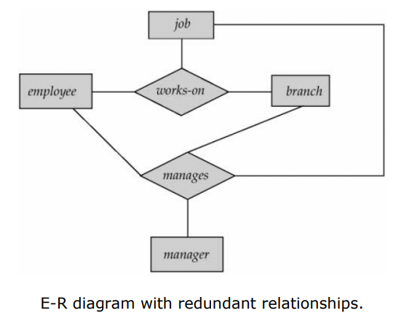
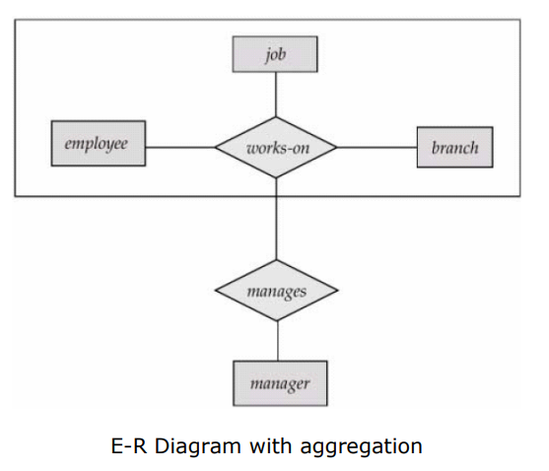
Aggregation
Notes:
Class discussion on real-world applications of databases.
Quiz on basic database terminology.
Hands-on exercise: Create a simple database using DDL commands.

Slide 30
Practical
Draw the ER diagram for a small database for a bookstore. The database will store information about books for sale. Each book has an ISBN, title, price and short description. Each book is published by a publisher in a certain publishing year. For each publisher, the database maintains the name, address and phone number.
Each book is written by one or more authors. For each author, the database maintains his/her ID, name and a short introduction. Each book is stored in exactly one warehouse with a particular quantity. For each warehouse, the database maintains the warehouse name, the location and the phone number. Each book has one or more sellers, which may be either companies (corporate vendors) or individuals (individual vendors).
Notes:
Class discussion on real-world applications of databases.
Quiz on basic database terminology.
Hands-on exercise: Create a simple database using DDL commands.

Slide 31
Practical
For each company, the database maintains a name of the company, its address, its phone numbers (there could be more than one phone number, each with a number and a description) and its contact person. For each individual vendor, the database keeps a name, a phone number and an email address. A contact person whose company sells a book cannot be selling the same book as an individual vendor at the same time (he/she may sell other books as an individual seller).
Notes:
Class discussion on real-world applications of databases.
Quiz on basic database terminology.
Hands-on exercise: Create a simple database using DDL commands.

Slide 32
Practical
Identify all the entities
-AUTHOR
-PUBLISHER
-BOOK
-CUSTOMER
-SHOPPING_BASKET
-WAREHOUSE
Notes:
Class discussion on real-world applications of databases.
Quiz on basic database terminology.
Hands-on exercise: Create a simple database using DDL commands.

Slide 33
Practical
find the relations
1.Each book is written by a author
2.Each book has a publisher
3. Some shopping baskets may contain more than one copy of same book
4. The warehouse stocks several books
5. A customer owns several shopping basket
Notes:
Class discussion on real-world applications of databases.
Quiz on basic database terminology.
Hands-on exercise: Create a simple database using DDL commands.

Slide 34
Practical
Identify the key attribute
*AUTHOR- name
*PUBLISHER- name
*BOOK- ISBN
*CUSTOMER- email
*SHOPPING_BASKET- basket_ID
*WAREHOUSE- code
Notes:
Class discussion on real-world applications of databases.
Quiz on basic database terminology.
Hands-on exercise: Create a simple database using DDL commands.

Slide 35
Practical
Identify other relevant attributes
*AUTHOR- name,address,URL
*PUBLISHER- name,address,URL,phone
*BOOK- ISBN,year,title,price
*CUSTOMER- email, name,address,phone
*SHOPPING_BASKET- basket_ID
*WAREHOUSE- code, address,phone
Notes:
Class discussion on real-world applications of databases.
Quiz on basic database terminology.
Hands-on exercise: Create a simple database using DDL commands.

Slide 36
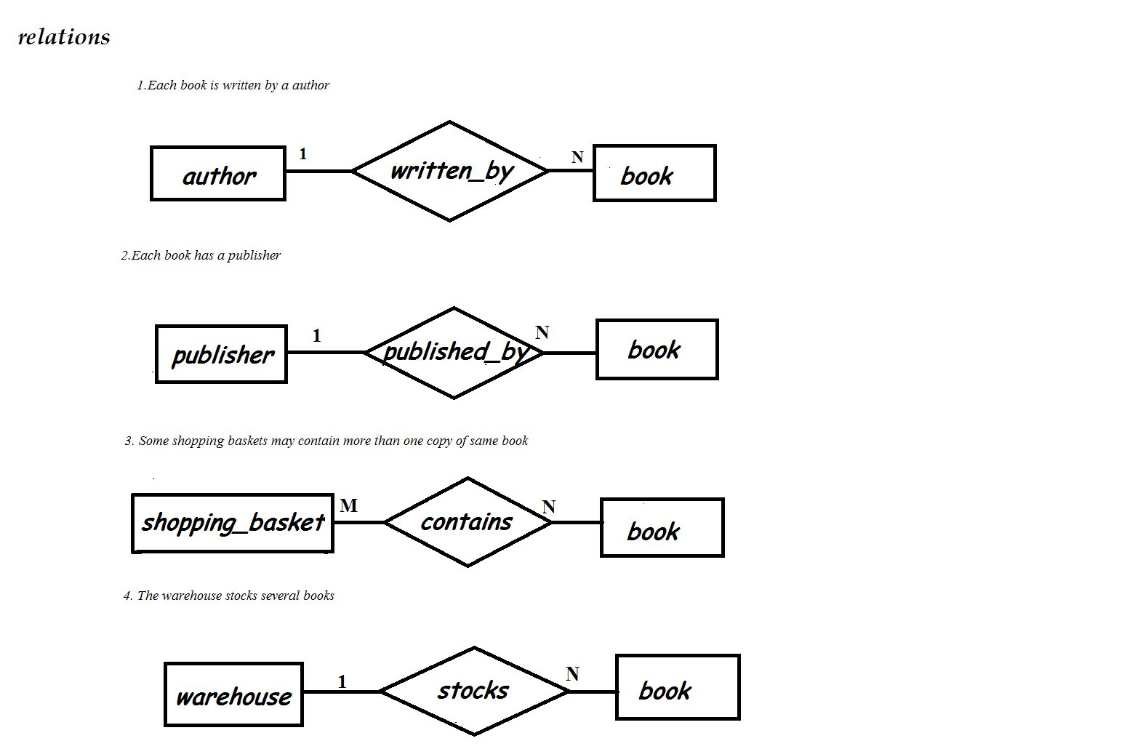
Practical
Notes:
Class discussion on real-world applications of databases.
Quiz on basic database terminology.
Hands-on exercise: Create a simple database using DDL commands.

Slide 37
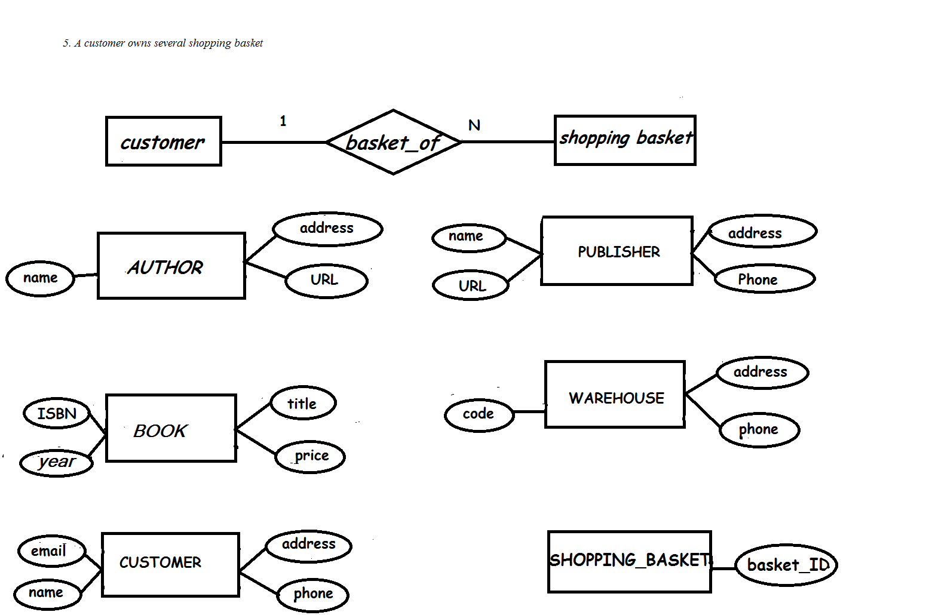
Practical
Notes:
Class discussion on real-world applications of databases.
Quiz on basic database terminology.
Hands-on exercise: Create a simple database using DDL commands.

Slide 38
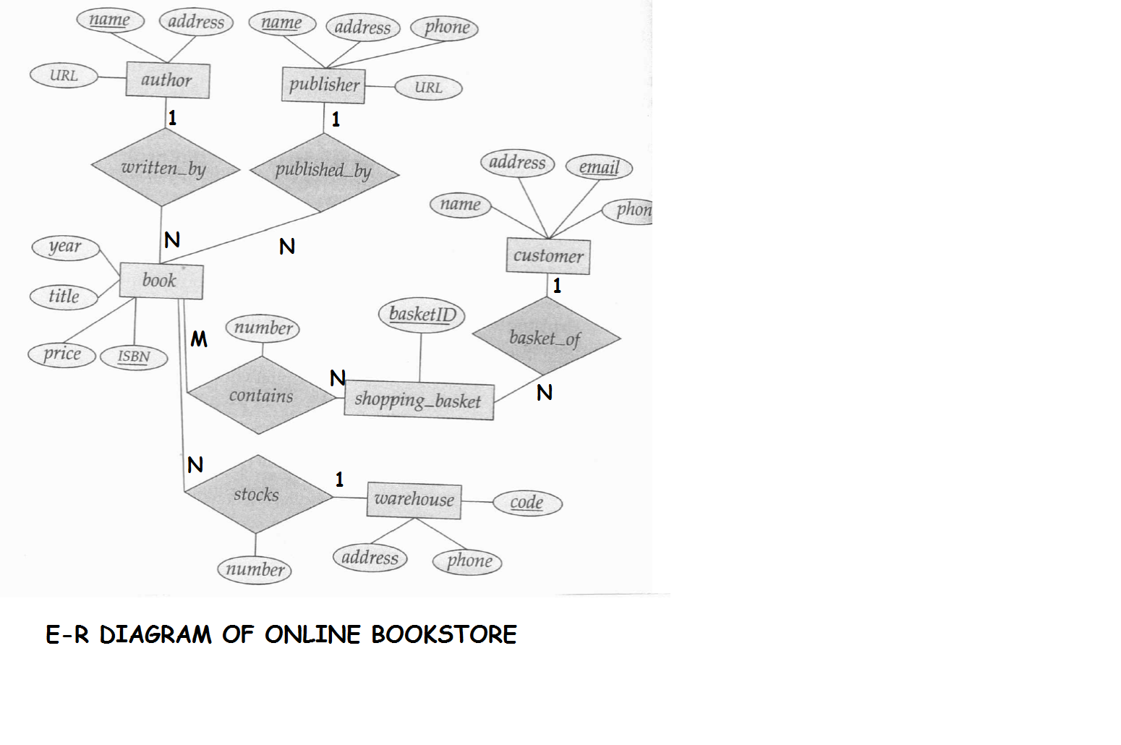
Notes:
Class discussion on real-world applications of databases.
Quiz on basic database terminology.
Hands-on exercise: Create a simple database using DDL commands.

Slide 39
END OF LECTURE 7
SHIVA.KUNWAR@HOTMAIL.COM
+977-9819123654
Google classroom code : drbzdcf

Slide 40
PREVIEW FOR LECTURE 8
RELATIONAL MODEL
INTRODUCTION TO RELATIONAL DATABASE
DATABASE SCHEMA AND VIEWS
RELATIONAL MODEL CONSTRAINTS

